Slide 1
JavaDocs
Creating Comprehensive Codebase documentation

Slide 2
What are JavaDocs?
  JavaDocs are comments written using a specific format that you include in your Java class
  These comments can then be used by a JavaDoc compiler to generate an API for that class
  Example of JavaDocs: The Java online API

Slide 3
Where are JavaDocs Written?
  JavaDocs are written in two main locations:
    Above a class signature (class comment)
    Above a method signature (method comment)
  Class comments indicate what a class is used for.
  Method comments indicate what a method is used for.

Slide 4
What is the Format of a JavaDoc Comment?
  All JavaDoc comments work should be structured around the same basic format:
    Open JavaDoc comment block using /**
    Single sentence (terminated with full stop) giving brief summary of the method/class functionality.
    Paragraph giving longer description of the method/class functionality (using HTML for any formatting you wish to include)
    Tags detailing specifics of the class/method
    Close JavaDoc block using */
  Style note: To avoid line wrapping interfering with your comment formatting, make sure to break lines at the 80 character mark.

Slide 5
Example of a JavaDoc Method Comment
Notation to begin a JavaDoc comment
/**
  * Retrieves the Customer matching a supplied name.
  *
  * Iterates through the supplied array to find the customer with
  * the same name as that supplied as a parameter.
  *
  * @param Customer [] custList An array of Customers to be searched
  * @param String nameToLookFor The name of the Customer being
  * searched for
  *
  * @return A Customer object matching that name, or null if no
  * match was found
  */
  public Customer searchByName(Customer[] custList, String nameToLookFor){
Summary of the method’s functionality
Auto-inserted
Expanded explanation of functionality
Tag information
End of Comment
Method begins

Slide 6
Tag Types
  Tags are included to explain a specific entity involved in the code in more detail, for example:
    Explain what a specific parameter is used for
    Explain what the possible return values are and what they mean
  We will focus on a subset of tags
    @param : Indicates that the line of text is discussing one of the method’s parameter.
      You should include one for each parameter taken in by the method (in the order they appear in the method’s brackets)
      These define your algorithm’s INPUTS
    @return: Indicates that the line of text is discussing the method’s return value
      This is usually defining, and explaining, your algorithm’s OUTPUT
    @throws: Indicates that the line of text is discussing an exception that can be thrown by the method
      You should include one for each possible exception that can be thrown (in alphabetical order)

Slide 7
Using Tags
  When using tags, the correct format is:
    @tagName entity name explanation of entity
  Component explanations:
    tagName: The tag you are using (e.g. param, return etc.)
    Entity name: the name of entity being discussed (e.g. the name of the parameter you are explaining)
    Explanation of entity: Your explanation of that entity (e.g. what the parameter you are explaining does)
  Examples:
    @param productCode The code of the product to be amended in the database
    @throws SQLException Thrown if the database has not been loaded onto the server, the server has not been started or the product table’s structure has changed

Slide 8
Another Example of a JavaDoc Method Comment
/**
  * Amends the name of any product in the database matching the supplied
  * code.
  *
  * Updates all products in the database matching the supplied productCode,
  * where productCode is the primary key. This method should update at most
  * one row in the database.
  *
  * @param productCode The productCode of the product to be amended
  * @param newProductName The name to which this product entry should be
  * changed.
  * @return The number of product entries changed in the Product table.
  */
  public int updateProductName(String productCode, String newProductName){

Slide 9
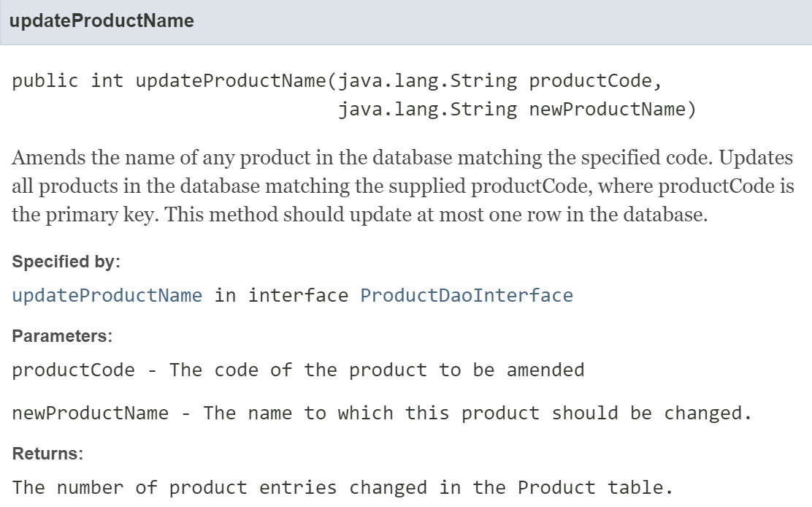
Corresponding JavaDoc API Entry
Auto-Generated by JavaDoc compiler due to method appearing in implemented interface

Slide 10
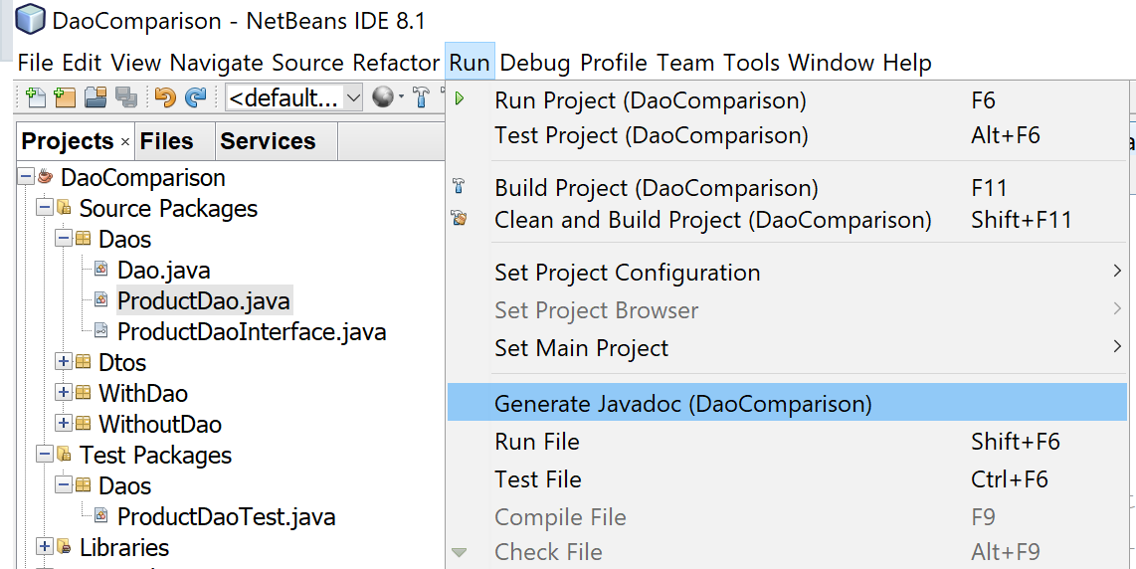
Generating JavaDoc APIs in Netbeans
  Netbeans contains a built-in JavaDoc API generator
This is from an old version, but it’s in the same place in Netbeans 15!

Slide 11
Expectations With Regard to JavaDocs
  You are expected to provide JavaDocs in any submitted code
  Your JavaDocs should be reasonably detailed
    Include a brief, 1 line explanation of what the method does
    Include a longer explanation where the method has some subtleties
  Your JavaDocs should use tags (and include explanations)
    @param where parameters appear in your method
    @returns where the method returns something
    @throws where the method throws an exception (will see more of this later)

Slide 12
This isn’t Ok – Why?
/**
  * Searches for a Customer
  *
  * @param Customer [] custList
  * @param String nameToLookFor
  *
  * @return Customer
  */
  public Customer searchByName(Customer[]
  custList, String nameToLookFor){

